Slide 1
Which do you like, taco or Burrito?
Peng He (birdy.hp@gmail.com)
Pei-Chun Lai (pclaitamu@gmail.com)
2019 TAMU-Datathon

Slide 2

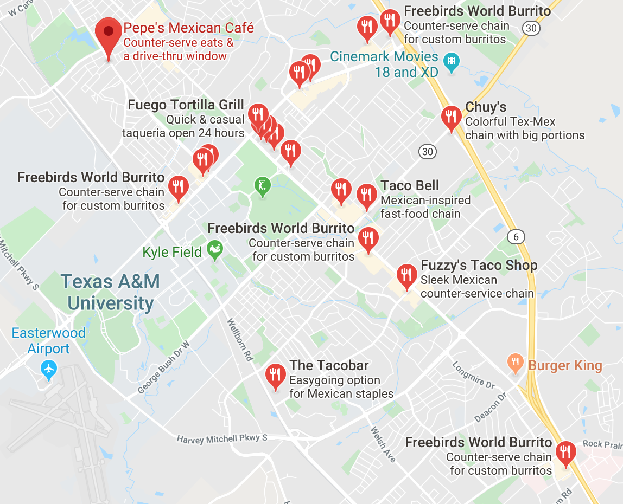
Warm up …
Trivia
Taco/Burrito restaurants found in all U.S. states and DC, PR, VI.
In Japanese, the word for octopus is "tako". The word for taco is "takosu" (literally tacos) to avoid confusion.
There are 20 Taco/Burrito restaurants in Bryan-CollegeStation. (Try’em all !)
Taco? Tako?

Slide 3
Data Introduction
This dataset contains a list of 19,439 restaurants and similar business with menu items containing "burrito" or "taco" in their names provided by Datafiniti’s Business Database.
Each row corresponds to a single menu item from the restaurant. Each restaurant may have one or more menu entries. This dataset includes restaurant and menu information. Only burrito or taco items on the menu are listed.
The significant variables of restaurant are
city: The city of the restaurant (business) location.
name: The restaurant (business) location's name.
state: The state of the restaurant (business) location from US government census data.
postalCode: The postal or zip code of the restaurant (business) location.

Slide 4
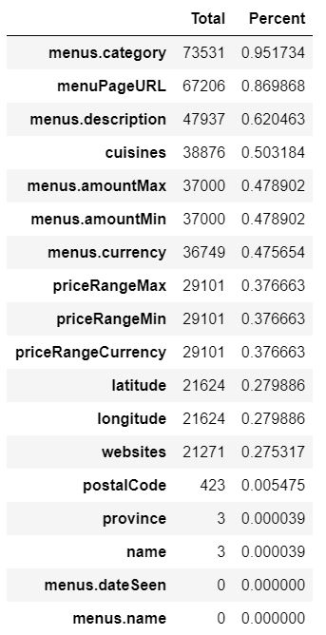
Data Introduction, con’t
The significant variable of menu is
menus.name: The item's name on the menu.
Missing data
Most missing data is menu related information, such as
menus.category: The menu section this item belongs to.
menuPageURL: A list of URLs where this item was seen.
menus.description: A description for the item.
The most important menu item, menus.name: the item's name on the menu, is complete provided.

Slide 5
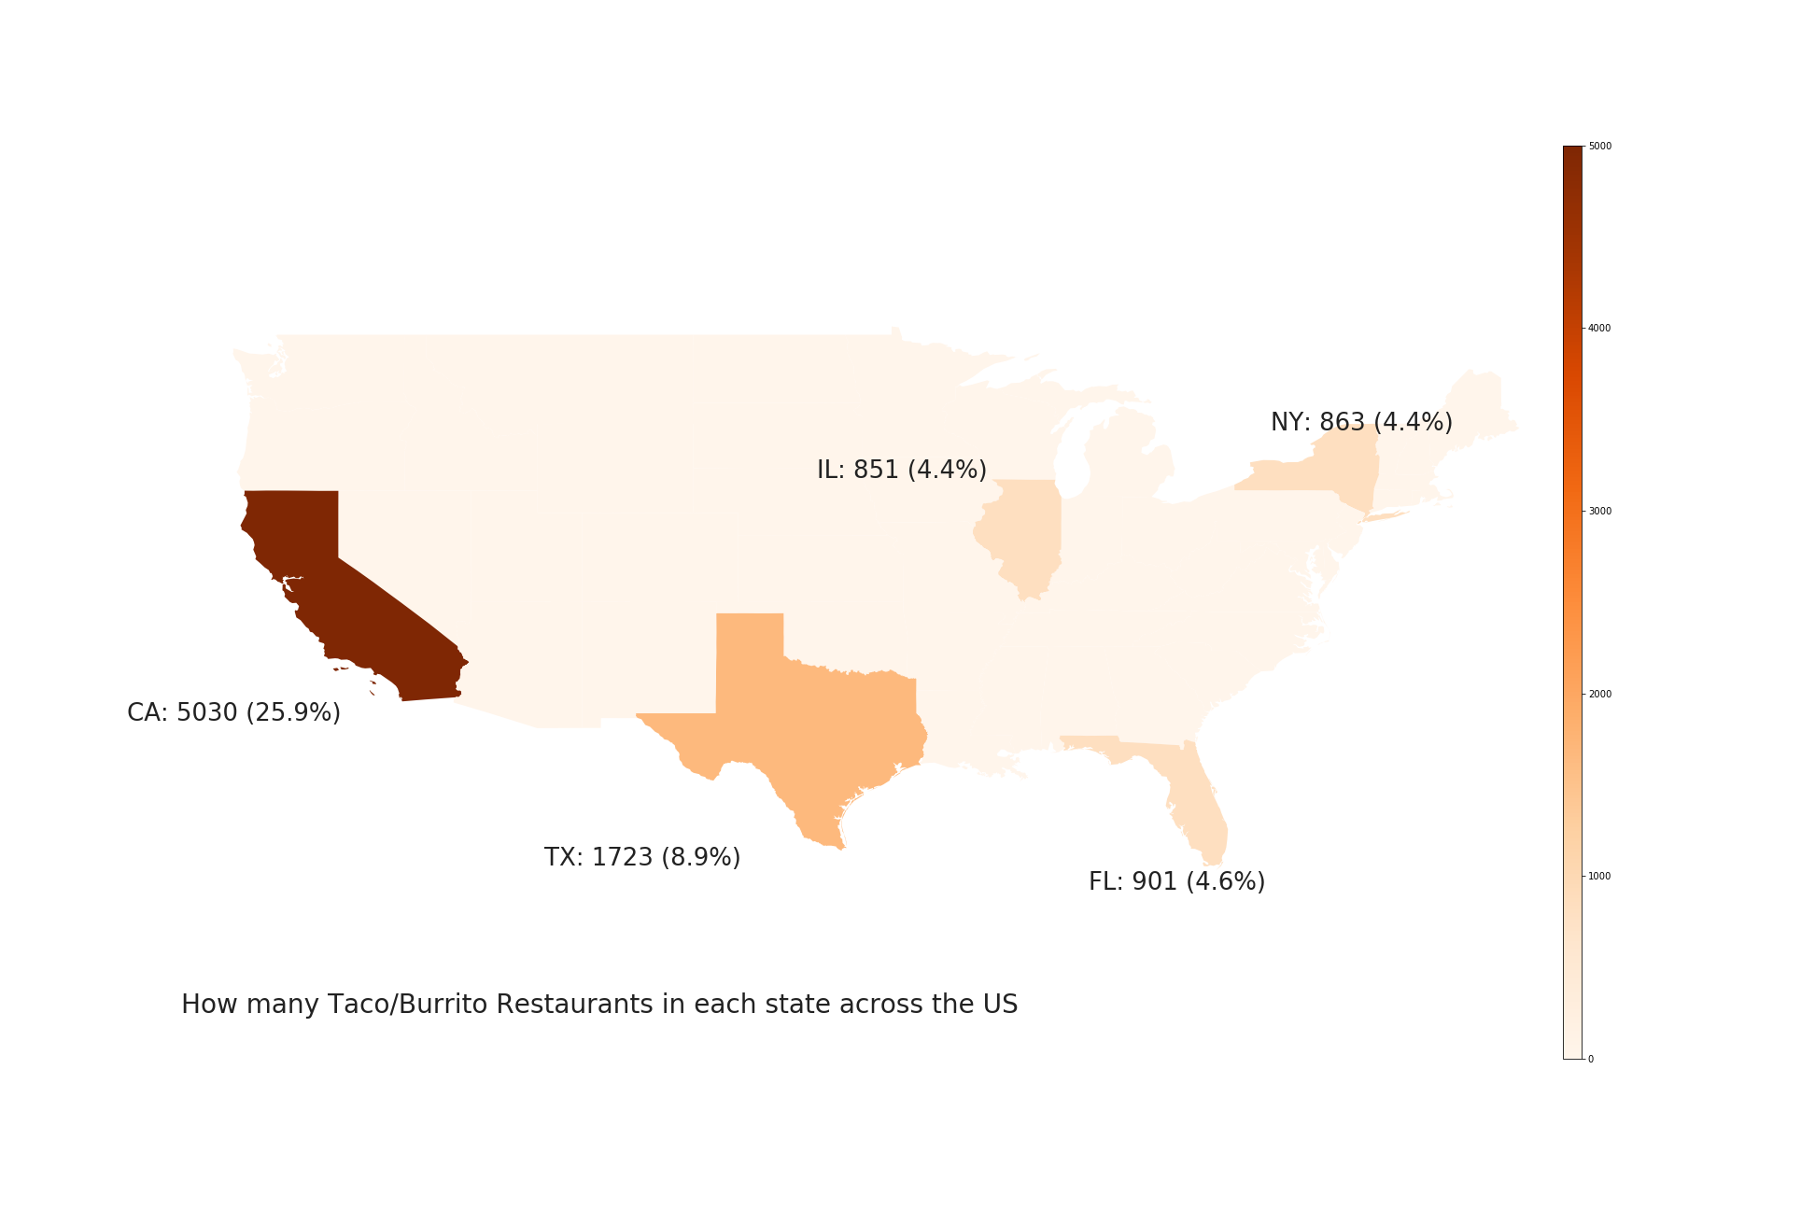
Distribution of the Taco/Burrito Restaurant across the US
The percentage of taco/burrito restaurants located in AK is 0.03%. The percentage of taco/burrito restaurants located in HI is 0.4%. We do not show these result in the map.

Slide 6
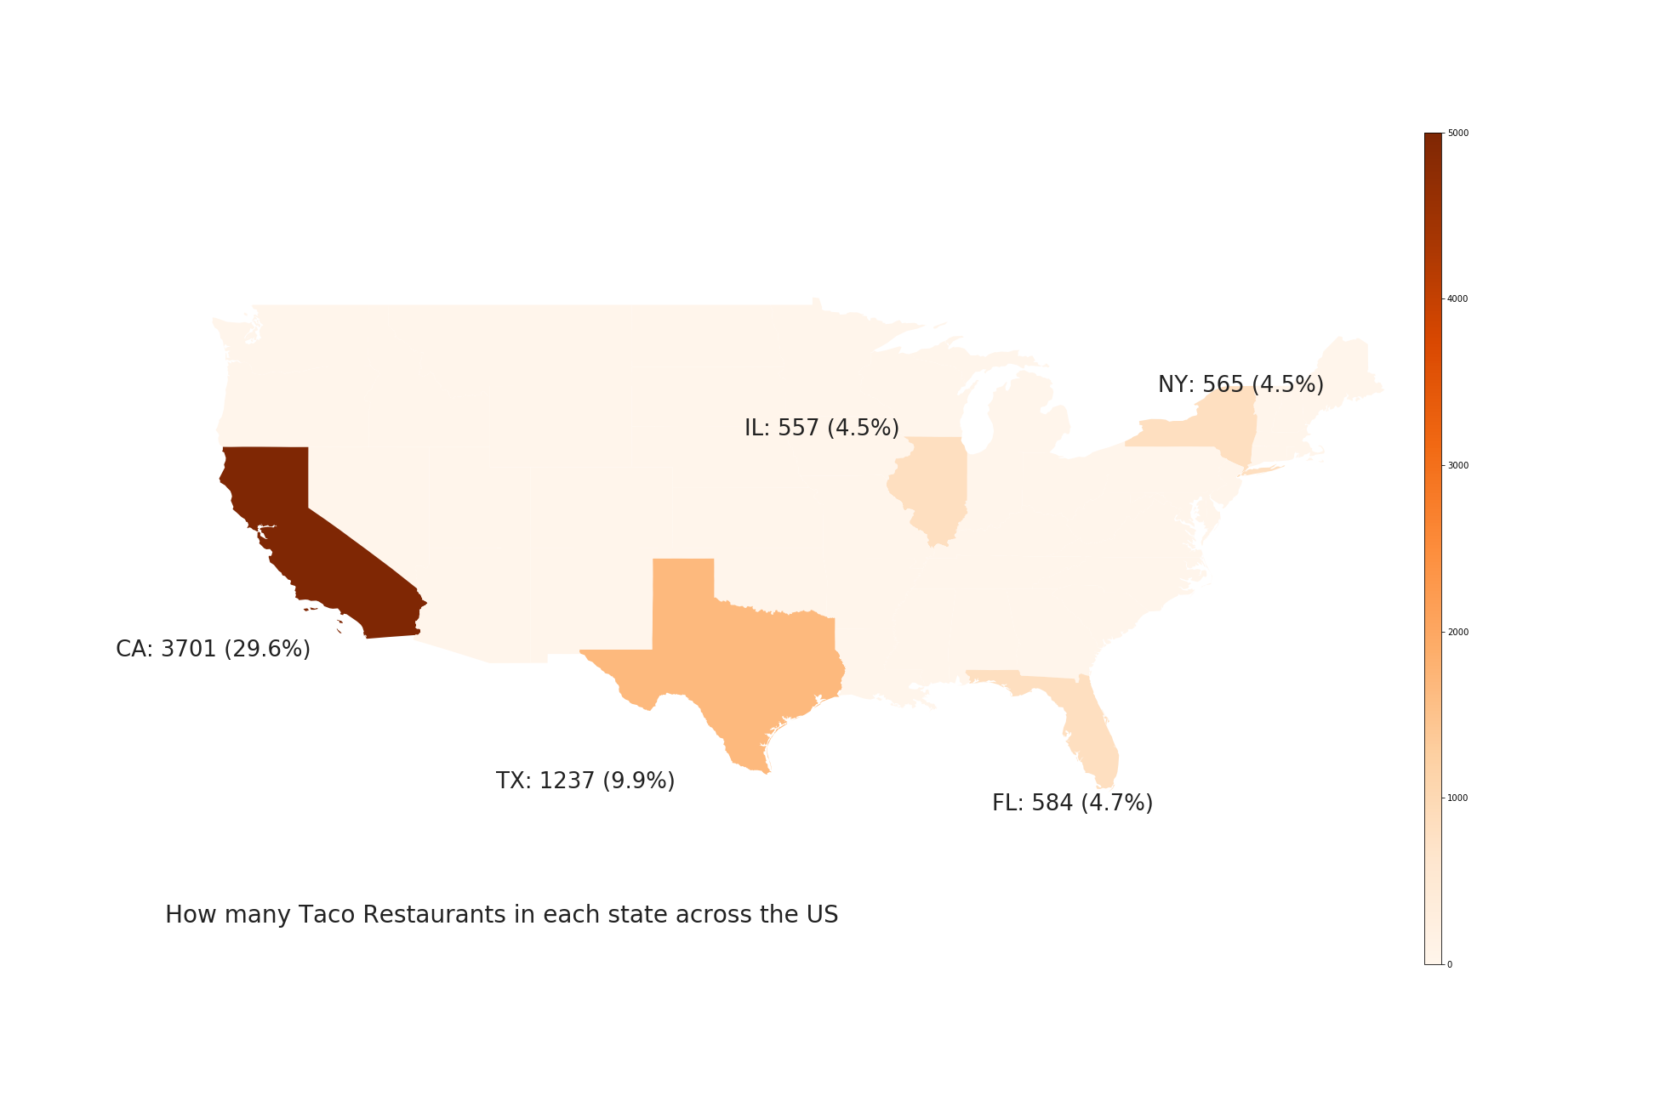
Distribution of the Restaurant Selling Tacos across the US
The percentage of the restaurants selling tacos in AK is 0.05%. The percentage of restaurant selling tacos in HI is 0.39%. We do not show these results in the map.

Slide 7
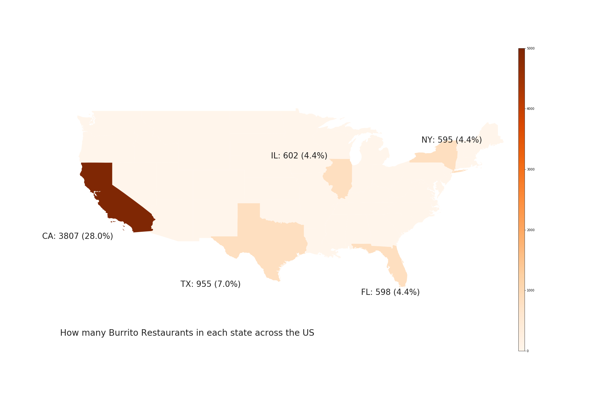
Distribution of the Restaurant Selling Burritos across the US
The percentage of the restaurants selling burritos in AK is almost 0. The percentage of restaurant selling burritos in HI is 0.4%. We do not show these results in the map.

Slide 8
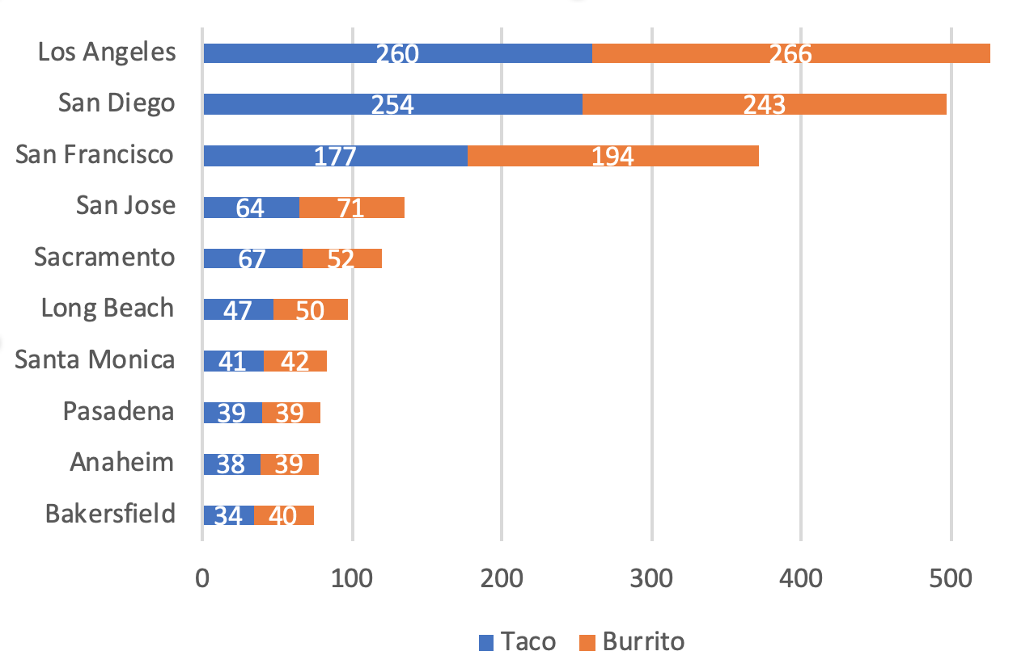
California, for Taco go south, for Burrito go north!
Drive along the coast line, San Francisco, Los Angeles, and don’t forget San Diego !!!

Slide 9
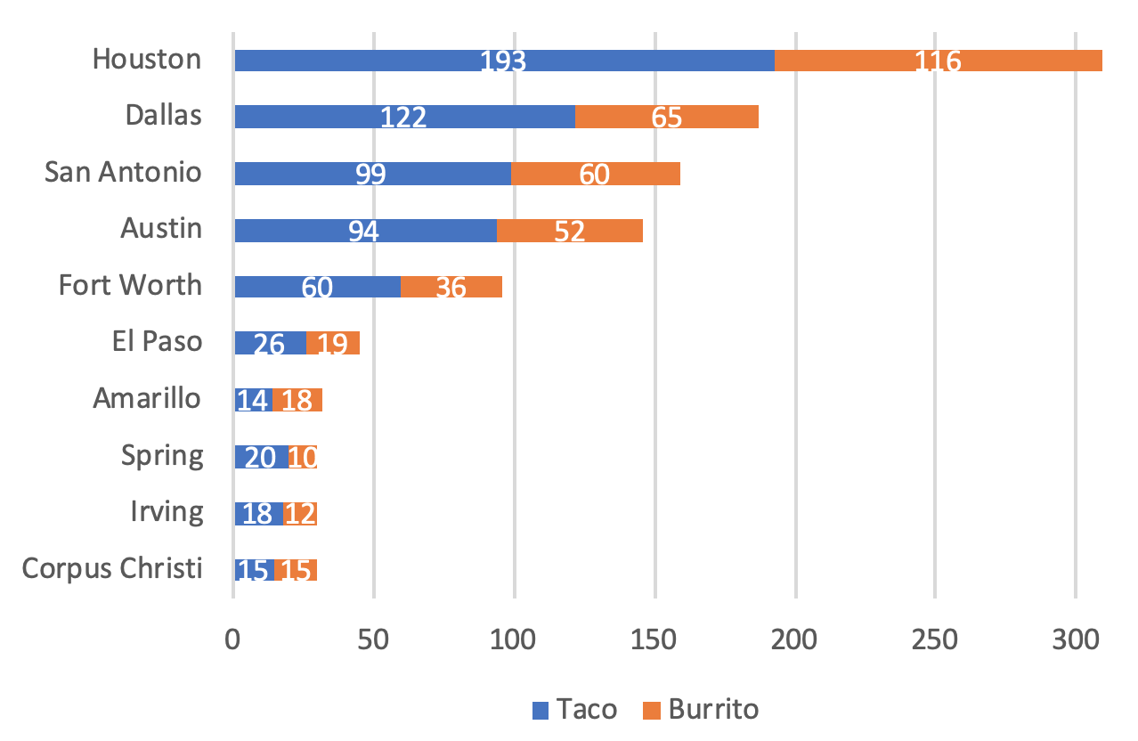
Texas Favors Tacos over Burritos!
Houston
→ San Antonio
→ Austin
→ Dallas-Fort Worth
Enjoy the tour in Texas !!!

Slide 10
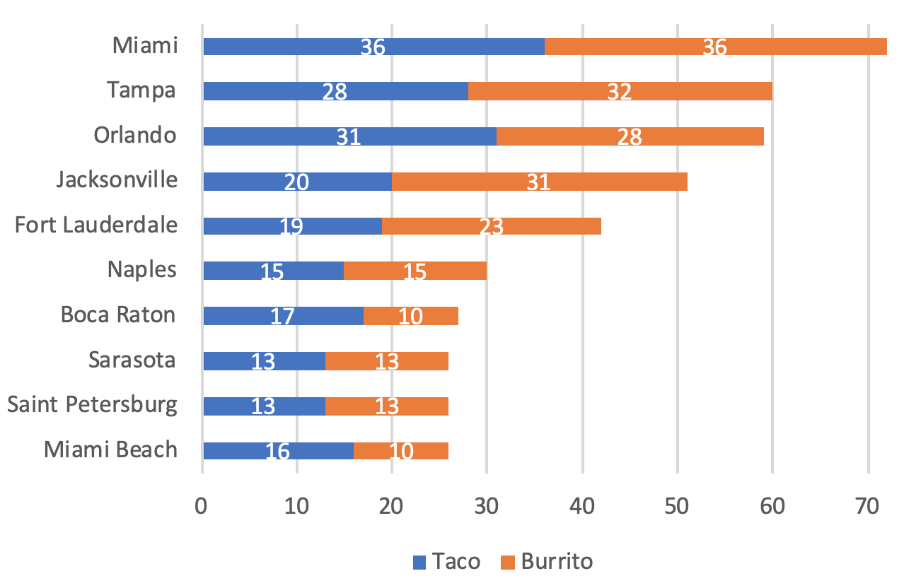
Tacos/Burritos, Everywhere in Florida!
Anywhere,
Everywhere !!!

Slide 11
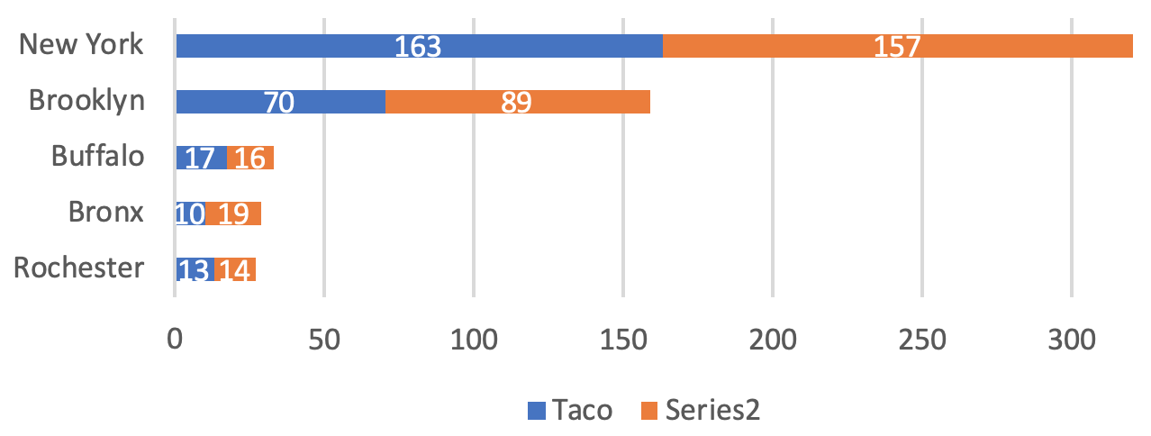
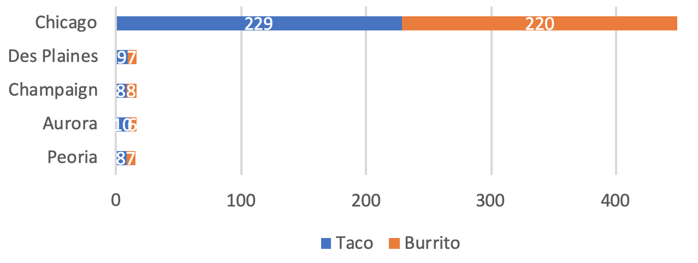
Top City in NY & IL
All in one, bro,
all in one !!!

Slide 12
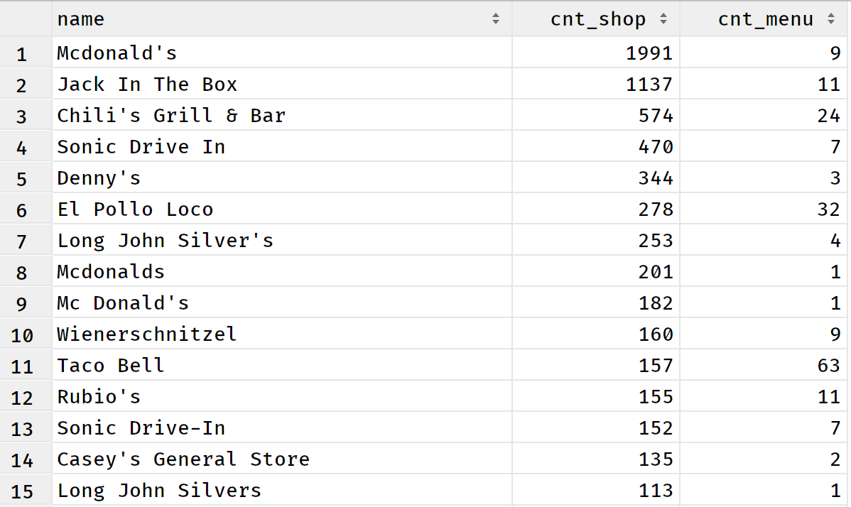
Thousands of chain restaurants contribute to the prevalence and popularity of Tacos/Burritos

Slide 13
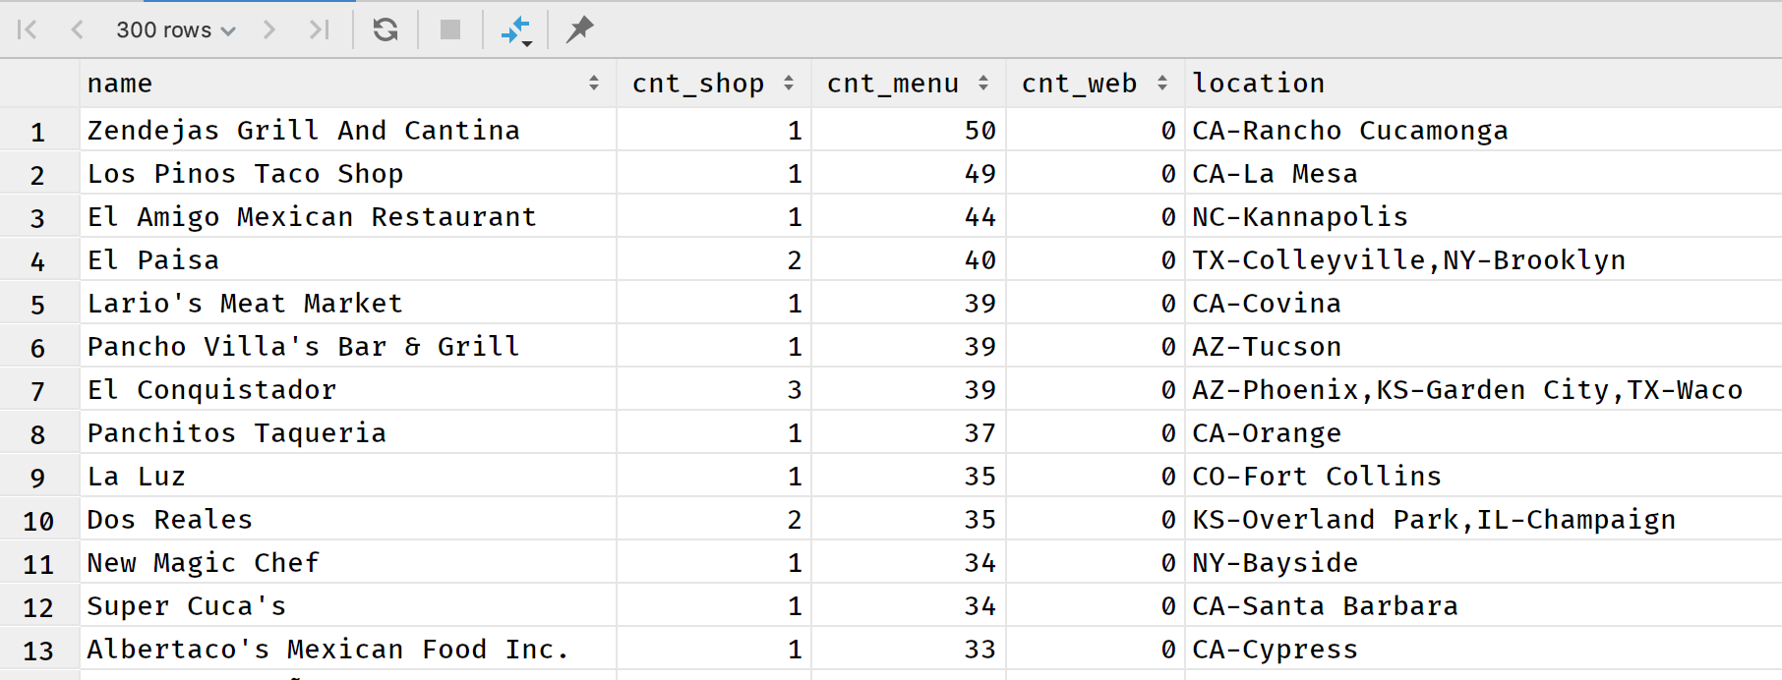
Hundreds of authentic Mexican restaurants has no website, adding one might significantly boost their business

Slide 14
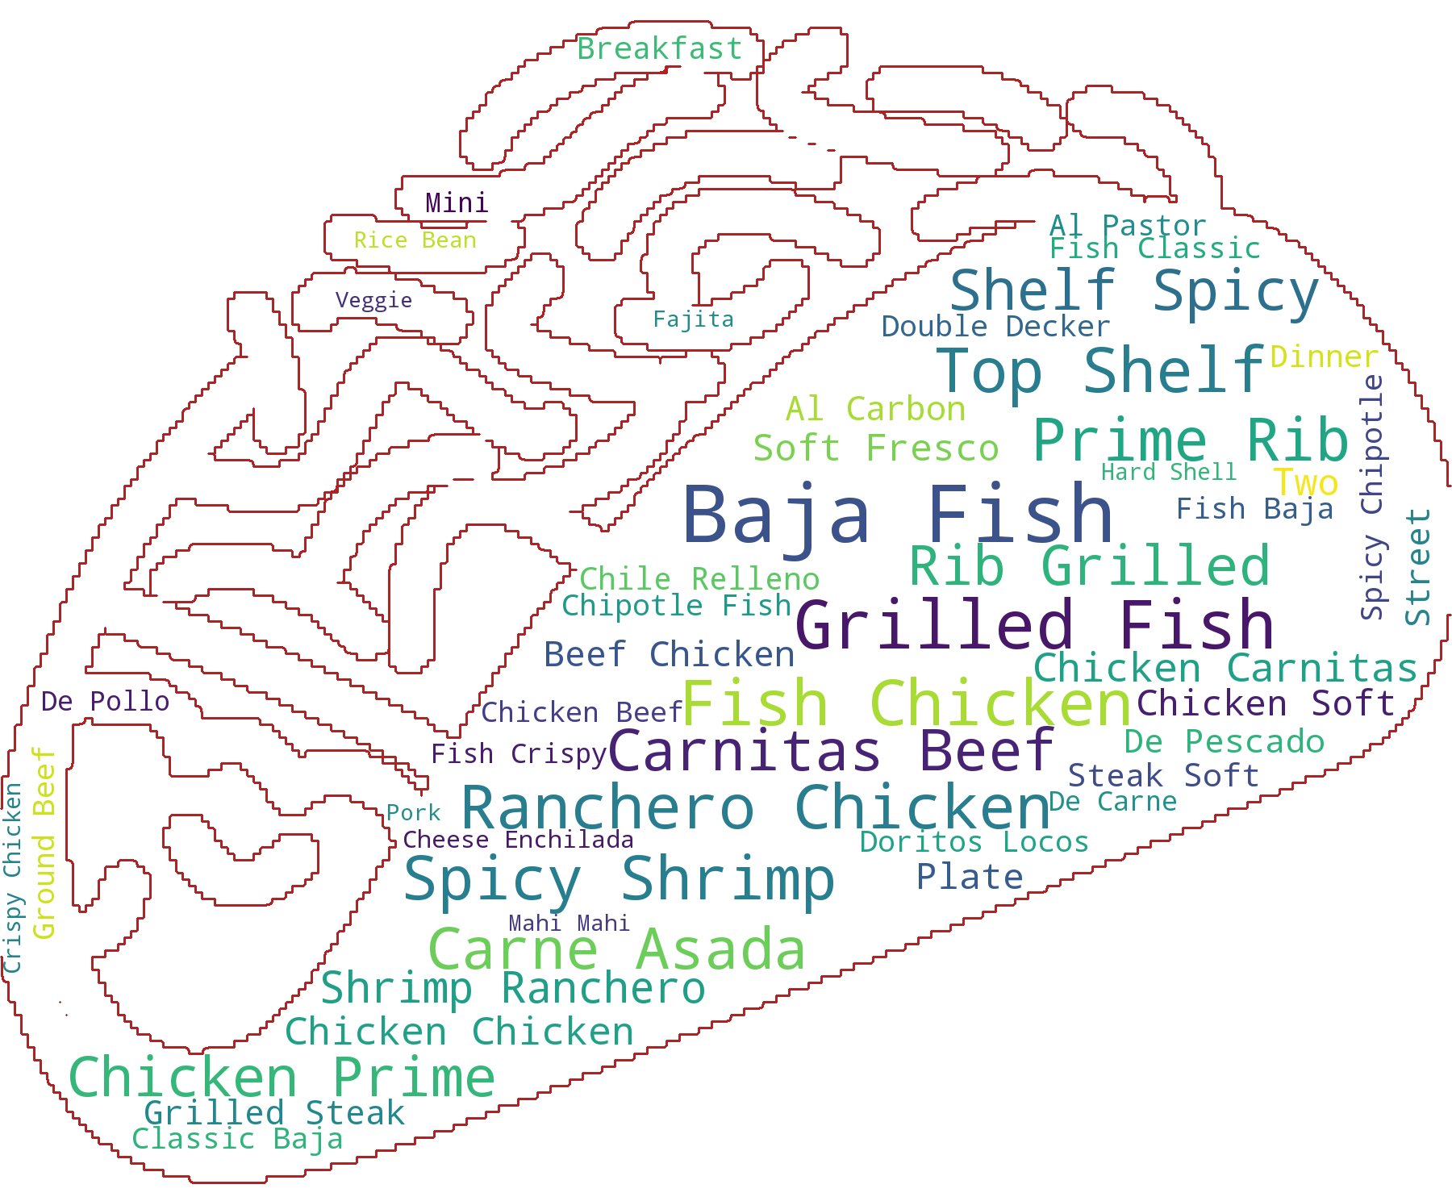
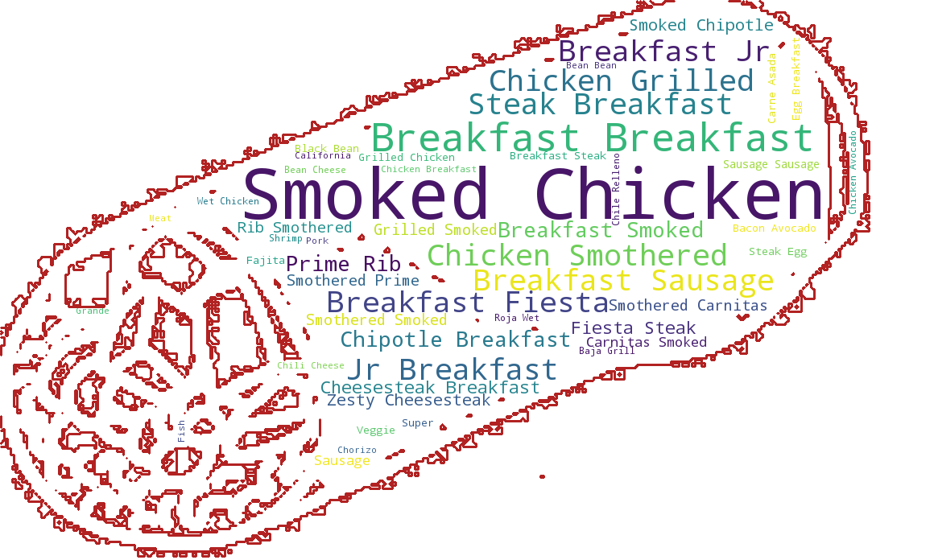
What goes with Taco/Burrito on the menu

Slide 15
Challenges on the quality of data
11% of the data (8,499 records) has city/town name in the “province” column fix: look up the state name using zip code in US gov census public dataset.
Unrealistic price on the menu. Can you believe a taco will cost $1,990? suggestion: check for misplaced decimals and other ETL errors
Significant ratio of missing data in most of the columns suggestion: use third-party data sources (Yelp, Google, …) or reasonable guess to fill missing spots
Several columns, e.g. “categories”, have multiple entries inserted in one cell.
Most of data last updated in 2016 and 2017

Slide 16
Thank you!

